Slide 1
N-GRAM MODELS
By Adil Mehmood

Slide 2
DEFINITION
N-grams are sequences of characters or words extracted from a text.
N-gram models are probabilistic models of text that use some limited amount of history,
word dependencies, where n refers to the number of words that participate in the dependence relation.
N-grams of texts are extensively used in text mining and natural language processing tasks.

Slide 3
Cont...
For example, for the sentence "The cow jumps over the moon". If N=2 (known as bigrams), then the ngrams would be:
the cow
cow jumps
jumps over
over the
the moon
How many N-grams in a sentence?
If X=Num of words in a given sentence K, the number of n-grams for sentence K would be:

Slide 4
Cont….
N-garam model uses word dependencies to assign a higher probability to “how are you today” than to “are how today you”, although both phrases contain the exact same words.
The use of bigram models (n-gram models with n = 2) would allow the system to model direct term dependencies, and treat the occurrence of “New York” differently from separate occurrences of “New” and “York”.
The use of trigram models would allow the system to find direct occurrences of “New York metro”, etc.

Slide 5
Cont...
N-grams. Specifically, a language model (LM) estimates the probability of next words given preceding words.
A word N-gram language model uses the history of n-1 immediately preceding words to compute
The occurrence probability P of the current word. The value of N is usually limited to 2 (bigram model) or 3 ( trigram model).

Slide 6
Cont...
Interesting facts
The Google n-gram counts were generated from approximately 1 trillion word tokens of text from publicly accessible Web pages.
Chris Harrison created some visualizations for bigrams and trigrams that start with pronouns.
For example, among the top 120 trigrams, 'He' and 'She' have many common second words. However, they differ on some interesting ones, for example, only 'he' connects to 'argues', while only 'she' connects to 'love'."

Slide 7

Cont...
These visual comparisons allow us to see differences in how the two subjects are used.

Slide 8
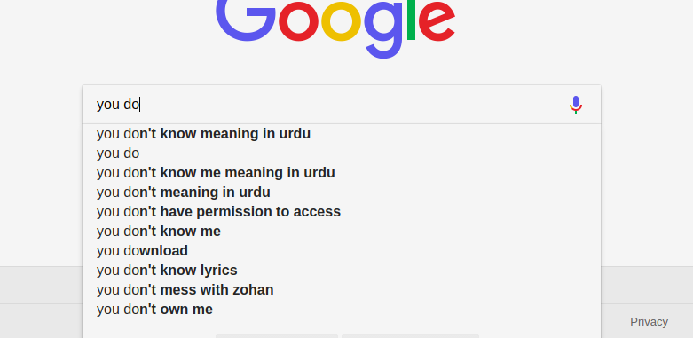

For example, among the top 120 trigrams, 'He' and 'She' have many common second words. However, they differ on some interesting ones, for example, only 'he' connects to 'argues', while only 'she' connects to 'love'."
When I tried to Google it

Slide 9
Cont..
Google Ngram Viewer
Google have digitised over 20 million books and made them searchable by word frequency
Google Trends
Google trends is similar to google Ngram Viewer but instead of searching books you’re searching search terms.

Slide 10
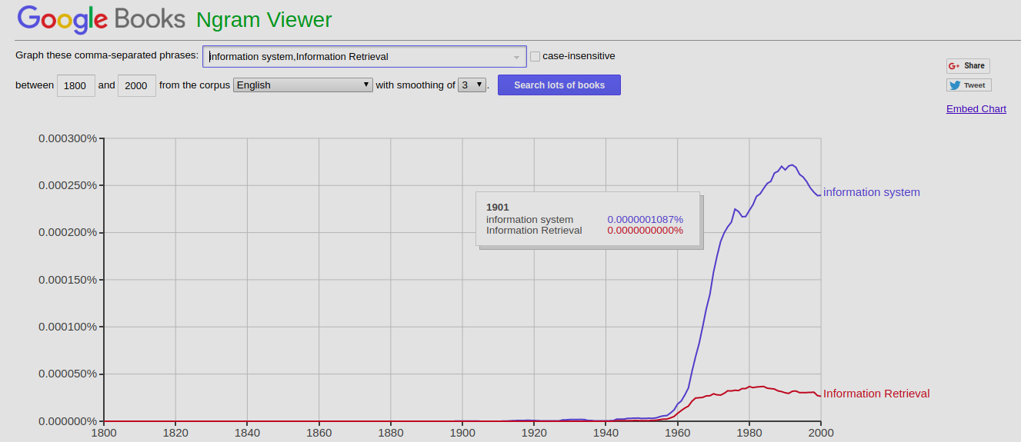
Google N-gram view

Slide 11
What are N-grams used for?
N-grams are used for a variety of different task. For example, when developing a language model, n-grams are used to develop not just unigram models but also bigram and trigram models. Google and Microsoft have developed web scale n-gram models that can be used in a variety of tasks such as spelling correction, word breaking and text summarization.

Slide 12
Completion Prediction
A language model also supports predicting the completion of a sentence.
  Please turn off your cell _____
  Your program does not ______
Predictive text input systems can guess what you are typing and give choices on how to complete it.

Slide 13
Cont...
Auto complete
Malicious Code Detection
common passwords
natural language processing.
speech recognition
Spell checking
…..

Slide 14
https://research.googleblog.com/2006/08/all-our-n-gram-are-belong-to-you.html
http://citeseerx.ist.psu.edu/viewdoc/download?doi=10.1.1.126.8275&rep=rep1&type=pdf
http://joelsperanza.com/tech-tip-tuesday/ngram-viewer-and-trends/
https://googlesystem.blogspot.com/2008/05/using-googles-n-gram-corpus.html#gsc.tab=0
https://pdfs.semanticscholar.org/bed1/a30e955f08f7c682e32b0b4f8495da5be07e.pdf

